Slide 1
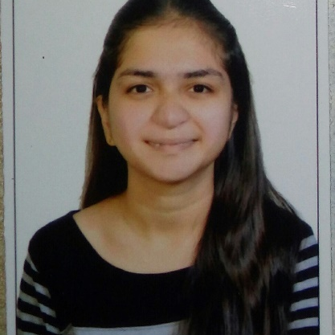


Neha Khadode
Analyst/Software Engineer
Bachelor of Engineering, Computer Science and Engineering :
2016 - 2021
Skills
Mumbai
Java 8 /J2EE | Java Basics, OOPS, Generics, Collections, Arrays, Loops, Servlets, Frameworks including Spring, Hibernate
C# | C#Basics,OOPS,Generics and Colllections, Serialization, Events, FileIO
.NET Framework | ADO.NET,Entity Framework and LINQ, Architecture which includes CTS,CLS,CLR
Database | MYSql, SQL Server Management Studio, Oracle
ADO.NET | Basics, Connected and disconnected Architecture
Tools | Git, Maven, IDE, Netbeans, Eclipse, Visual Studio
Add On skills | Peer learning
NEHA.KHADODECAPGEMINI.COM
+91 9823260454
A4
Hands on experience on C#,ADO.NET,LINQ,Entity framework,Sql Server,ASP.NET
Hands on experience in developing web pages using HTML5, CSS3, Java script, ES6, JSON, XML. Good understanding of Document Object Model (DOM) and DOM Functions.
Intranet File sharing and Chatting System Project in JAVA.
Face Mask Detection using Python-OpenCV.
Completed case study on Pharmacy Management System which is used to manage the drugs as well as supplier details and user can also login and order drugs whereas admin will be verify that order.
Completed Certification on Microsoft AZ-900, AZ-104, Agile development.
Completed the training on iTransform-Microsoft .Net Core and Azure Fundamentals
https://github.com/nehakhadode

